Slide 1
Budget Boot camp module 2: budget management documents
Dr. Andrew Miner, DPA
Acting Deputy Director, State Budget Division
andrew.miner@state.nm.us, 827-3812

Slide 2
Module overview
Budget Management Documents – documents that agencies prepare and submit to SBD during the fiscal year to adjust their budget per legislative and statutory authority
Budget Adjustment Requests (BARs)
Types and Authority
How to submit a complete BAR
Appropriate backup documentation
Budgeting Nonrecurring Appropriations – OPBUD-4s and Allotment Forms
Special Cases: Reauthorizations and Companions
Adjusting Nonrecurring Appropriations – Budget Reallocation Forms (BRFs)
Demonstrations for completing forms

Slide 3
Submission process for BARs, OPBUD-4s and BRFs
Email to DFASBD.Submissions@state.nm.us
SBD Office Manager (or backup) will log in and route to analyst
Include Excel version of BAR, OPBUD-4, or BRF Form
Include all backup documentation as one PDF
Include appropriate word in email subject line to aid in filtering:
BAR – Budget Adjustment Request
BRF – Budget Reallocation Form
OPBUD4 – The form utilized for nonrecurring appropriations

Slide 4
SBD review process
Office Manager logs into system, gives control number
1a. BARs – Director does initial review for appropriate use of funds
Initial Analyst review
Team Lead review
Director final review
4a. Non-federal BARs – 10 day wait for LFC passive review. Can request waiver.
Posting – team of posters each assigned one day, do not post items that they have reviewed
General fund allotment forms (usually sent with OPBUD-4s) are sent to FCD for processing

Slide 5
Budget adjustment requests (BARs)
Requests by agency to adjust current-year recurring operating budget (Section 4) according to authority granted by legislature in GAA, either general to all agencies or specific to that agency
Agencies may do “internal” BARs that adjust budgets lower than the P-code level independent of DFA review. Any adjustment to a P-code level budget must be submitted to DFA.
LFC has 10 day passive review of all P-code BARs except those involving federal funds
Types
Budget Increase – Request to increase budget according to granted authority (never GF)
Budget Decrease – Request to decrease budget. Rare but can happen such as to align budget with federal grant amounts
Category Transfer – Request to transfer budget authority from one expenditure category to another
Program Transfer – Request to transfer budget authority from one P-code to another. Usually limited to specific agencies and/or programs denoted in GAA. Must transfer both expenditure and revenue budget.

Slide 6
Statutory authority for bars
BAR Statutes: 6-3-23 though 6-3-25 NMSA 1978
Special Revenue Fund Statutes
It is important to refer to language establishing special revenue funds in statutes, as this language will often dictate authority the agency has to increase the budget from this fund outside of the GAA.
“Money in the fund is appropriated to the department” = Agency has broad authority to submit increase BARs from this fund
“Money in the fund is subject to appropriation by the legislature” = Agency does not have authority to request increases beyond those allowed specifically in the GAA
Some funds do not have clear language. In such a case please consult your SBD analyst.

Slide 7
Gaa authority for bars
Note: Section labels may change slightly from year to year. Consult current authority document on SBD website.
Section 3 (I)
Allows agencies with excess revenue from board of finance loans, other acts of the legislature, gifts, grants, donations, bequests, insurance settlements, refunds or payments into revolving funds to request budget increases
General authority used for federal grant increases
Current FY BAR Authority section
Denotes specific authority to certain agencies to request budget adjustments for remainder of current FY

Slide 8
Gaa authority for bars
Next FY BAR Authority section
Establishes general authority granted to all agencies to request budget adjustments in next FY as well as specific authority granted to certain agencies
Subsection C: Authority for category transfers among PSEB, Contracts, and Other (not 500 category)
Subsection D: Authority for agencies with appropriations from Other State Funds or Transfers to request increases up to 5% of amount budgeted in Section 4.
Agencies that don’t have broad authority to request increases from special revenue funds must follow this limit
Remember that OSF and Fund Balance are grouped together under OSF in GAA
If you have both OSF and Transfers, 5% authority to limited to each source separately, not combined (cannot use Transfers budget to increase OSF & vice versa)
Subsection E: list of authority granted to certain agencies by fund, program and/or purpose
Note that blanket program transfer authority to all agencies is rare

Slide 9
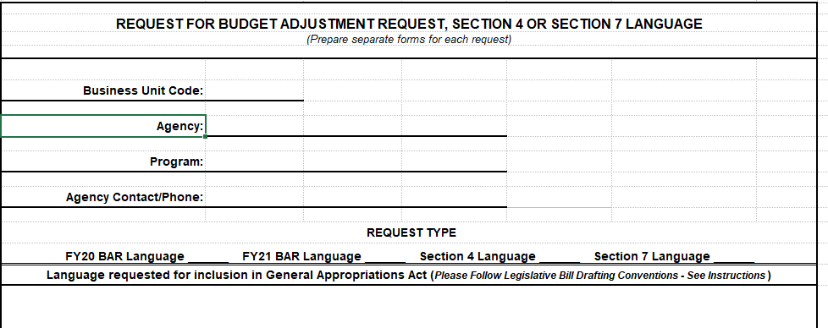
Requesting bar authority
DFA issues guidance to agencies in the fall for submitting BAR authority requests to be considered for inclusion in next session’s GAA
Submit language requests with short justification to both DFA and LFC
DFA and LFC recommend BAR authority for inclusion, LFC drafts bill. Opportunities for negotiation / revision during House and Senate process
Note that program transfer authority, even if specific, is difficult to get approved

Slide 10
Components of a complete bar
BAR Form (Excel)
Budget Journals (copies from SHARE, convert to PDF)
BAR Narrative (create in Word, convert to PDF)
Backup documentation depending on type of BAR, possibly including:
Copy of specific statutory authority (copy of general authority not needed – just citation)
Federal grant award and budget worksheet
5% worksheet
SHARE reports showing budget availability for category decrease
Budget projections
Utilize BAR Checklist on SBD’s website to ensure complete submission

Slide 11
Completing the bar form
Initiating Org: Pcode number and name
Use Budref and Class for Section 4 budget for that FY
Note proper format of Fund/Agcy/P-code entry (19800/516/P717). No 10-digit codes.
Don’t round or truncate numbers
Include positive and negative lines in transfer BARs
Break out revenue on right side

Slide 12
Completing the bar form
Be sure to include correct journal number(s)
Include appropriate statutory authority from GAA, statutes, etc
Complete revenue section which should tie to revenue above, include 6 digit code. Use correct equity code for fund balance BAR.
Mark type of BAR and check “No 10 Day Wait” box if BAR utilizes exclusively federal funds.
Ensure CFO or designee has signed form

Slide 13
Completing the bar narrative
Use correct narrative for type of BAR: Budget Increase, Budget Decrease, or Category Transfer (can be adapted for program transfers)
Narrative justification of why BAR is necessary – complete thoroughly and accurately. Be specific about what funds are being used for.
Especially important for category transfers such as requests to move budget out of 200 category
Keep in mind that the Budget Director reviews BARs for appropriateness and the LFC will review later and may have questions
Make sure information provided on narrative matches that on form, backup documents, etc.
Examples of completed BARs with narratives will be posted on Boot Camp Training website

Slide 14
Completing the bar journals
Budget Entry Type: BARs are always Adjustments, even if setting up a “new” budget for a federal grant
Entry Type is always BAR
Ensure that budget increases and decreases have a REVENUE and APROP_P journal
Ensure that a transfer BAR is created as a Budget Transfer journal
Ensure that journals have been approved at all agency levels to be routed to DFA
Department-level decrease journals for transfer BARs
Cannot be done as a transfer – must be done separately (first decrease, then increase)
Create and post department level decrease journal (Entry Type = AGY) before submitting BAR to DFA, include copy of posted journal in backup
After DFA posts BAR, create and post department level increase journal (otherwise it will error out – child exceeds parent budget)
Refer to Module 3 for full details on journal creation

Slide 15
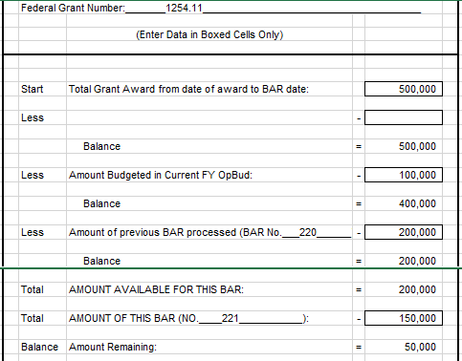
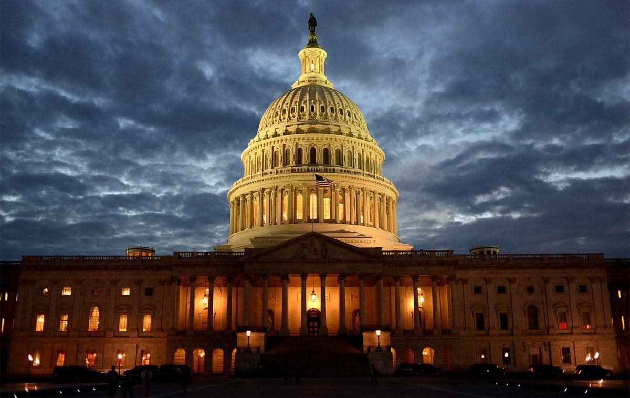
Backup for federal increase bars
Copy of grant award that details available funding amount and period of award
Completed grant recon sheet showing any previous established budget and this BAR
May consolidate more than one award into one BAR but need recons for each

Slide 16
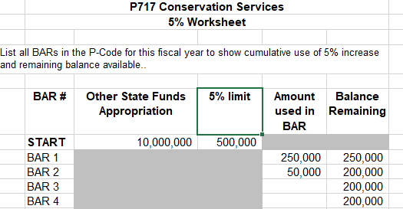
Backup for other increase bars
Special revenue fund statutes detailing authority to increase
Copy of fund trial balance report showing available fund balance and correct equity code as well as fund balance reconciliation sheet
Copy of MOU or similar document if receiving funds from other entity
Completed 5% worksheet if using that authority to increase

Slide 17
Backup for transfer bars
Up-to-date budget projections for P-code showing need for BAR
Copy of posted department-level decrease journal
Copy of SHARE budget status report showing sufficient budget in requested category to decrease
This Photo by Unknown Author is licensed under CC BY-SA

Slide 18
Bar 10 day waiver process
Complete BAR as normal – do not check “No 10 day wait” box on BAR form
Submit BAR to SBD, obtain 10 Day Waiver Form from Office Manager
Agency CFO must sign waiver form
Submit waiver form to LFC, must be signed by Director or Deputy Director
Return BAR and completed waiver form to SBD

Slide 19
Budgeting nonrecurring appropriations: OPBUd-4s
Most commonly budgeting items from Sections 5, 6, and 7 of GAA. Occasionally other legislation such as junior budget bills. Not subject to 10 day review by LFC.
Lump-sum: Agencies have authority to establish budget in different expenditure categories as needed, according to fulfilling the purpose of the appropriation.
Exception: May not establish budget in 500 category unless specifically directed by appropriation
Table of Budget Codes
Produced by SBD after every legislative session, posted on SBD website
Establishes Z-codes, class codes, and budrefs for all nonrecurring appropriations in GAA and other legislation. Consult and include copy of relevant line when submitting OPBUD-4s

Slide 20
Components of a complete opbud-4
Complete, signed OPBUD-4 Form (Excel)
Budget Journals – REVENUE and APROP_P
Budget Entry Type: Original (establishing new appropriation budget)
Entry Type: OPBUD-4
Copy of appropriation line from Table of Budget Codes
Backup dependent on type of appropriation:
Complete, signed allotment form if appropriation is from general fund, computer systems enhancement fund, or tobacco settlement fund
Copy of PCC certification letter if budgeting Section 7 IT appropriation, with certified amount matching what is being budgeted
Trial balance report if appropriation is from fund balance
Documentation that any contingencies in the appropriation have been met

Slide 21
Completing the OPBud-4 form

Slide 22
Completing the opbud-4 form
Use corresponding info from Table of Budget Codes, including statutory citation
CFO/designee should always sign top right section
Set up expenditure category budget as desired to fulfill purpose of appropriation
Use correct 6 digit revenue code (499105 for General Fund)
Be sure to include both journal numbers
Section 6 Certification: Only complete if appropriation is from Section 6 of the GAA, denoting an appropriation to fill a budget shortfall in the current or previous fiscal year
Ensure all info on the budget journals matching the OPBUD-4 form

Slide 23
Completing the allotment form
Funding Source: If not GF, specify Computer Systems Enhancement Fund or Tobacco Settlement Fund
Allotment Distribution Type: Accelerated (get all money at once)
Otherwise use same info from bill and OPBUD-4 Form

Slide 24
Special appropriation reauthorizations
If a nonrecurring appropriation is not spent entirely by its original end date, an agency can request an extension, typically granted for one additional fiscal year.
Budgeted via normal OPBUD-4 process after original budget period is over
Use same Z-code as original appropriation but new class code and budref per the Table of Budget Codes
Budget must be for remaining balance of appropriation – include SHARE report showing balance as of last day (6/30) of original period
Do not include allotment form – money was already sent

Slide 25
Companion bars and opbud-4s
Two possible use cases
Agency transfers funds from special revenue fund into operating budget and wants to increase OSF budget, thereby also increasing special revenue fund transfer. May even come from another agency in limited circumstances
Agency received nonrecurring appropriation from another agency’s special revenue fund and therefore needs to receive transfer from that agency before it can spend the money. Agencies will need to coordinate.
Procedure: 2 BARs or OPBUD-4s required (companions)
Budget with transfer revenue and expenditures in 200/300/400 as desired
Budget with original revenue (OSF or fund balance) and 500 category expenditure

Slide 26
Budget reallocation forms (brfs)
Used for two purposes:
Changes to established nonrecurring appropriations. Usually a category transfer. Increases are only allowed for federal funds.
Courts use BRFs as BARs since GAA gives them lump-sum Section 4 appropriations (can set up expenditure categories as they wish)
Not subject to 10 day LFC review
Components of a complete BRF
BRF Form (Excel)
Budget journal(s). Budget Entry Type: Adjustment. Entry Type: BRF. Create Budget Transfer journal for category transfer BRFs.
Documentation of federal funding availability if applicable
SHARE report showing available budget for category transfer
Courts submitting BRFs for Section 4 budgets should provide same documentation as required for a BAR of that type (increase, category transfer, etc.)

Slide 27
Completing the brf form
Use relevant Z-code, class, budref for the nonrecurring appropriation
Courts – Use your P-code, class and budref for that FY’s recurring budget if adjusting Section 4 budget
Include brief justification for change to nonrecurring appropriation

Slide 28
End of module 3 – budget management documents

