Slide 1
Budget Boot camp module 3: The share system for budget analysts
Dr. Andrew Miner, DPA
Acting Deputy Director, State Budget Division
andrew.miner@state.nm.us, 827-3812

Slide 2
Module overview
Creating budget journals in SHARE – Types, components and process
Demonstration in SHARE
Other processes in SHARE: Routing and posting journals, department level budgets, chartfield requests
Useful budget/financial reports generated from SHARE
Background and demonstration
Applications of information pulled from SHARE
Completing budget projections
50% rule verification

Slide 3
Creating budget journals in SHARE
Navigator > Commitment Control > Budget Journals > Enter Budget Journal > Add a New Value
Clicking Add when NEXT is in the Journal ID box will auto-generate a number for the journal ID once you save the journal
You may instead enter a custom ID if your agency has specific naming conventions
Generally all journals establishing a budget will need an appropriation journal and a revenue journal
TRANSFER: Navigator > Commitment Control > Budget Journals > Enter Budget Transfer > Add a New Value
Generally used to transfer budget authority in the same ledger group, such as from the 300 to the 400 category in a category transfer BAR
Adjust date as needed for when journal needs to be effective (such as 6/30/20 for a corrective adjustment to prior FY)

Slide 4
The budget header page

Slide 5
The budget header fields
Ledger Group
APROP_P: P-code level expenditure budget, entered at category level (200, 300, etc)
DEPT: Sub P-code level expenditure budget (category level). Note that revenue budgets are not entered at this level.
DETAIL: 6 digit line item expenditure level – not budgeted
REVENUE: P-code level revenue budget
Budget Entry Type
Original: used when establishing a budget for the first time (new appropriations)
Adjustment: used when adjusting an already established budget. Includes federal BARs for new grants (adjusting established federal budget)
Long Description: Describe purpose of journal, including reference numbers or statutory citations if applicable
Alternate Description: Generally not used, optional

Slide 6
The budget header fields
Curr Effdt
Generally match the date you established when you added the journal
Entry type
Very important as this determines how journal is routed
AGY: Agency level adjustments such as department-level BARs. Do not go to DFA for approval.
BAR: Budget Adjustment Request (any type) to DFA
BRF: Budget Reallocation Form (adjustment to nonrecurring appropriation or Court) to DFA
CBAR, CBRF, CBUD: Capital outlay requests to DFA Capital Outlay Bureau
OPBUD-3: Establishes recurring (Section 4) budget. Generated from external budget system and imported into SHARE. OPBUD-3 journals are almost never created directly in SHARE.
OPBUD-4: Establishes nonrecurring budget such as for Section 5, 6, and 7 appropriations

Slide 7
The budget lines page

Slide 8
The budget lines fields
Account
Enter expenditure category if in APROP_P or DEPT ledgers or revenue line if in REVENUE ledger
CAREFUL!! SHARE does not stop you from entering the wrong account type in the ledger you are in (possible to enter revenue codes in an APROP_P journal)
Fund
Enter fund number for journals
Use magnifying glass icon to look up if necessary
Department
Use P-code for adjustments to program level recurring budgets
Use Z-code for adjustments to nonrecurring budget / special appropriations
Use A-code for capital budget adjustments
Use 10 digit code for adjustments to department-level budgets in a DEPT ledger group journal with AGY entry type ONLY

Slide 9
The budget lines Fields
Class
All recurring Section 4 budgets have the same class in a fiscal year, such as E0000
Each nonrecurring appropriation has a unique class code that closely matches its Zcode (ZE5101, class E5101)
E2020: executive orders for calendar year 2020
Budref
All recurring Section 4 budgets have the same budref in a fiscal year, starts with 1 and ends with the FY (121)
Nonrecurring appropriations have 3-5 digit budrefs, such as 92024, with component parts:
9: denotes nonrecurring appropriation
20: FY in which the appropriation began
24: Authorized length of appropriation. Note this does not mean 24 full months but rather the remainder of the current FY and all of the next FY. 36 = rest of current FY + two more FYs, etc.
A three digit budref such as 921 is only valid in the denoted FY
Budrefs for nonrecurring appropriations are provided on the Table of Budget Codes

Slide 10
Budget lines fields
Amount
Enter amounts in whole numbers, not rounded
Enter reductions as negative numbers
Positive numbers will show as credits below, negative as debits
Be sure that debits and credits equal on transfer journals
Click the + under the lines to create a new line and copy the info down, adjust as needed
Saving and Submitting
Click Save below to save journal and give it a number if you didn’t give it a custom one
In drop down menu above lines, click Submit Journal and Process (Submit for Approval checkbox should auto-populate)

Slide 11
routing and Posting Journals
Level 1: When the journal creator submits a journal it should be routed to the next level of approver at the agency
Level 2 Agency Approval
AGY entry type: authority to approve in queue and post journal (click on Post Journal and Process in lines tab)
Other entry types: authority to approve in queue which submits to DFA
Level 3 DFA Approval
Authority to approve in queue and post journal
Agencies should never attempt to post own journals that are not AGY entry types

Slide 12
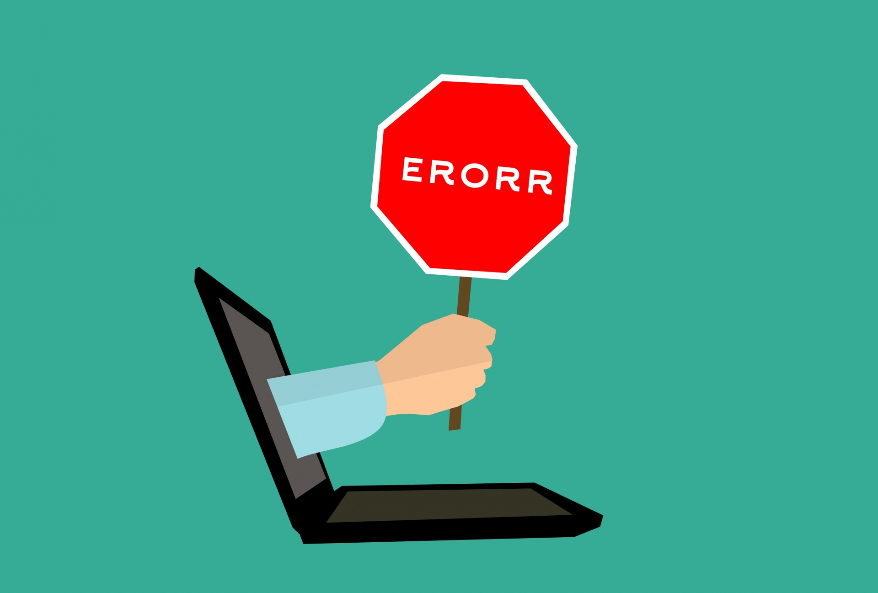
Journal errors
Generally the only errors SHARE will identify when you are creating a journal is if you try to enter an invalid value in a certain field
If you are certain the value is correct (such as a certain class code), contact your SBD analyst – may need to be activated
SHARE does not check journals against available budget until posting is attempted – please ensure accuracy of journal and prevent activities from hitting budget until posted
Most common journal errors encountered by SBD when posting
Details found by clicking on Error next to Budget Header Status
Child Exceed Parent: DEPT level budget was not reduced before attempting to reduce APROP_P budget
Exceeds Budget Tolerance: Not enough available budget to reduce by journal amount
Value not at CF Level: Some sort of incorrect entry in account, department, class field that SHARE didn’t pick up on initially (for example, revenue accounts entered in APROP_P journal)

Slide 13
Establishing department level budgets
Lower-level budgets using 10 digit department codes that roll up to P-code budget, used by larger agencies to subdivide their budgets. No revenue budget.
Not controlled by SBD except to check that a department level budget is reduced before an APROP_P level category transfer BAR
Agencies may create journals in SHARE to set up these budgets and post with 7/1 effective date after SBD has posted APROP_P level budget journals for new FY
Ledger group DEPT, Entry Type AGY.
Account should be expenditure categories
Same class and budref as current FY recurring budget

Slide 14
Department level budget journal example

Slide 15
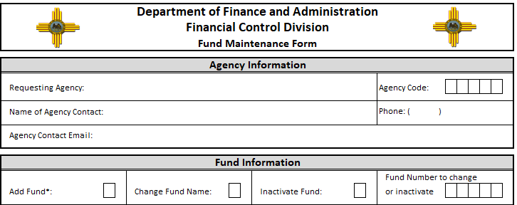
chartfield requests, department and fund maintenance forms
Used to establish new fund, inactivate fund, create new department code, change accounting structure, etc.
Reviewed and approved by both FCD and SBD
Find in SHARE: Setup Financial Supply Chain > Common Definitions > Design Chartfields > Define Values > Chartfield Request
Complete and attach appropriate Fund or Department Maintenance Form, ensure info on the form matches info entered in SHARE. Forms on FCD website.
For more assistance contact your SBD analyst, FCD or the SHARE Help Desk

Slide 16
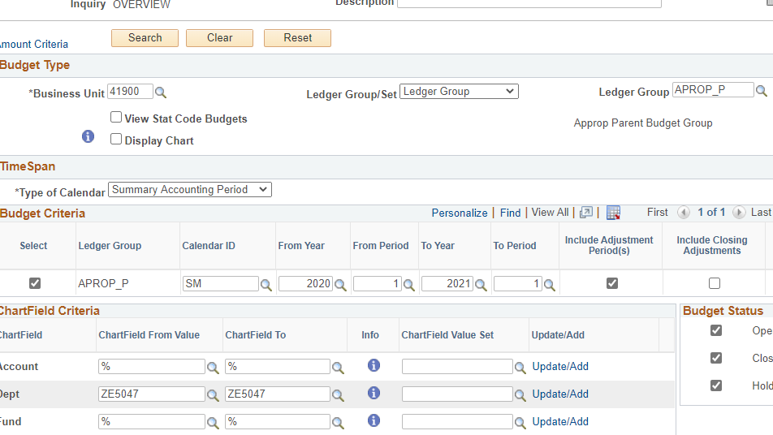
budget overview report
Navigator > Commitment Control > Review Budget Activities > Budget Overview
Shows budget, expense, encumbrances for a P-code or other budget for certain number of FYs in selected ledger group

Slide 17
Budget overview report
Ledger Group: Can look at expenditure or revenue budget, select Detail if you want to see expenditures at 6 digit line item level
Type of Calendar: generally use Summary Accounting Period
Calendar ID: SM. Note if pulling up by FY, enter 1 in both period fields
Chartfield Criteria
Leave % in any fields that you want to return all possible values (no filter)
Enter same value in From and To fields if you only want results for that value
Account: enter range of accounts you want depending on report’s ledger group
Dept: could be P-code, Z-code, 10 digit code, etc.
Click on Search button near top of report to run

Slide 18
budget overview report
Can download results into Excel using button at right above results lines, so you can manipulate data, create pivot tables, etc.

Slide 19
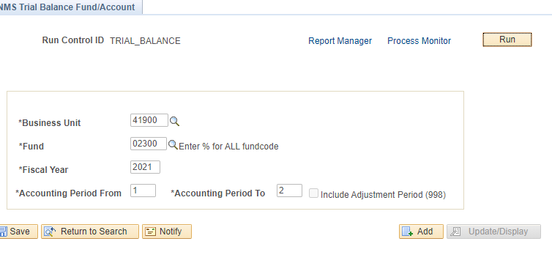
Trial balance report
Useful for tracking revenue and expenditure history of funds, getting fund balance of special revenue funds for BARs and budgeting purposes
Navigator > General Ledger > General Reports > NMS Trial Balance Fund/Account

Slide 20
Trial balance report
Enter fund, fiscal year, and accounting period (may specify range of months)
Click Run, then OK.
Click Process Monitor, click Refresh until Run Status = Success and Distribution Status = Posted
Click Report Manager
Click on report in Excel format on left

Slide 21
Trial balance report – result in excel

Slide 22
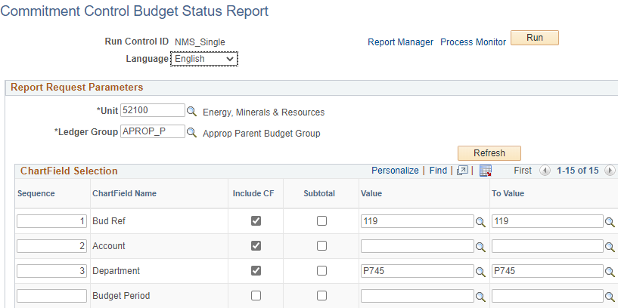
Single year Cafr budget status report
Navigator > Commitment Control > Budget Reports > Budget Status
Select chartfields to include in report, sequence to be ordered in, and range of values for each
Follow same Run > Process Monitor > Report Manager sequence as for Trial Balance Report

Slide 23
Single year Cafr budget status report
Output will be PDF
Results tie more closely to Geneal Ledger than Budget Overview

Slide 24
Completing budget projections
Template available on SBD website, Budget Adjustment Requests tab
Updated every FY with new account codes and number of salary hours (such as 2,080)
Use for budget management and planning during FY
Submit to DFA as BAR backup (showing need/effect of BAR) and budget availability for HR actions such as raises or upward reclasses of positions
Complete one projection packet per P-code, and different tabs for each funding source within that P-code
Category tab is a summary rollup and copies from detail tabs – shouldn’t need to hard type any numbers here

Slide 25
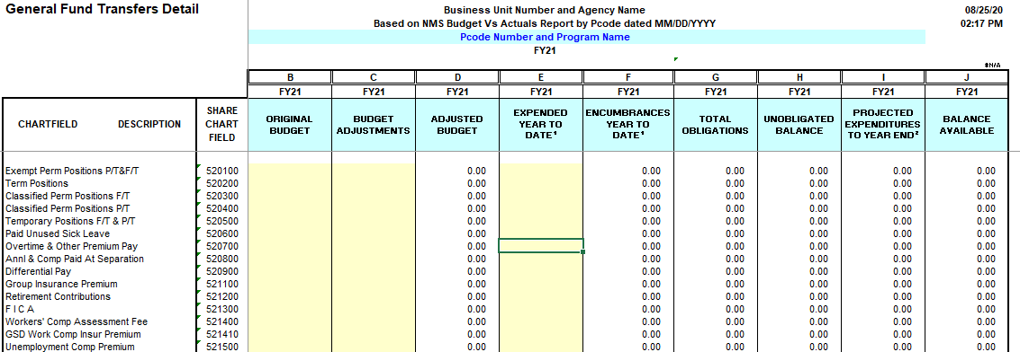
Completing budget projections
Detail tab
Populate column B with line item budgets, column C with adjustments through BARs
Populate columns E and F with actual expenditures / encumbrances from SHARE reports at detail level
Column I (projected expenditures) in the 200s (PSEB) will populate from data entered on Salary Projections tab. Manual entry required for 300s, 400s, 500s

Slide 26
Completing budget projections
Salary Projections tab
Complete each field with current HR data
Class = Exempt, Term, Exempt, Perm F/T, Perm P/T, Temp
Obj Code = job classification
Enter annual salary, hourly wage will autopopulate
Enter remaining pay hours based on current data and payroll schedule tab
Enter insurance costs per pay period dependent on employee’s insurance plan and salary
Projected remaining costs for each line item will calculate in column S > used for PSEB projections on Detail tab
Vacant Positions
Enter remaining work hours based on when you plan to fill position
Enter zero if no plans to fill position
Enter salary based on estimate of what you plan to pay position, use midpoint of salary range if unsure
Use single coverage to estimate insurance costs

Slide 27
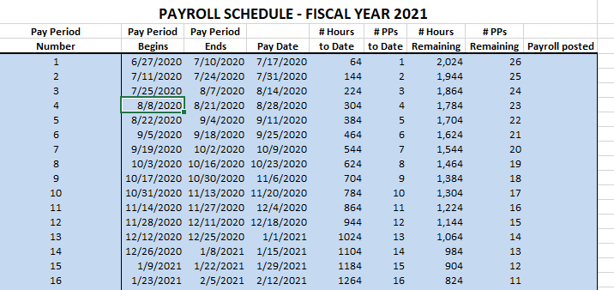
Completing budget projections

Slide 28
50% rule verification
6-3-6 NMSA 1978: State agency expenditures for the first 6 months of every odd-numbered fiscal year are limited to one half of the approved budget for that year
Ensure that at least half of an agency’s budget is available to new agency heads or elected officials taking office after an election
Does not apply to legislative committees, legislative council, State Fair
Applies to agency as a whole, not individual programs
Can request exemptions for certain portions of budget – must be approved by DFA Secretary
Around December 1 of each odd-numbered FY agencies must submit verification that they are in compliance with the 50% rule
Instructions and forms distributed by SBD in advance
Use SHARE reports to verify actual expenditure data and rule compliance

Slide 29
End of module 3 – the share system for budget analysts

